Slide 1

Field Instructor Orientation
BASW/MSW Students

Slide 2
Training Objectives
Understand roles & responsibilities for stakeholders in field education
Identify 3-5 ways to orient student to organization
Identify developmental stages of internship experience
Identify at least 2 ways to help students integrate theory into practice
Develop skills to respond to challenging student situations
Know the paperwork requirements (Learning and Evaluation Tool (LET), process recording)

Slide 3
Purpose of Field Education
Students will develop:
  Professional identity
  Self-understanding
  Integration of theory and practice
  Skills toward competent practice
Field Education is 28% of graduate and 10% of undergraduate degree requirements
BASW/MSW first placements are generalist practice, with both micro and macro experiences
Second MSW placement or advanced standing are concentration focused

Slide 4
Roles & Responsibilities

Slide 5
Field Instructor Qualifications
For BASW students: A baccalaureate degree in social work or BA degree with extensive social service practice experience
For MSW students: An MSW degree with two years of post-master’s experience, license preferred

Slide 6
Field Instructor (FI) Responsibilities
To the Student
To the School
Provide orientation to the agency and agency paperwork
Assist in developing the Learning Agreement
Coordinate educational opportunities
Provide weekly, 1hr supervision
Provide ongoing feedback
Assist student with challenging situations (with clients & organization)
Participate in field trainings
Complete mid-semester verbal evaluation
Consult with liaison re: issues/concerns
Report any changes that affect field placement:
  If FI leaves agency/changes supervisor to student
  If learning activities drastically change
  If there are concerns about student performance
Complete, sign, and return all field related forms/documents
Notes:
This is YOU!

Slide 7
Benefits of Field Instruction
$5 CEUs for appointment year 7/1-6/30
Appointment as Clinical Faculty with MSU
  Library privileges
  Use of intramural facilities and Forest Akers Golf Courses
  Purchase of athletic tickets at faculty rate
  MSU identification card
  Eligibility for faculty membership in University Club
  Parking privileges (must purchase permit)
  MSU Net ID/Email

Slide 8
Student & School Responsibilities
Student Responsibilities to FI/Agency
School Responsibilities to FI/Agency
Participate in development of learning activities
Prepare for supervision & take active role in learning
Follow rules/policies
Maintain professional behavior
Adhere to NASW Code of Ethics
Report safety issues to FI
Address concerns appropriately
Assign field liaisons
Provide consultation, mediation, problem solving
Monitor internship progress
Review Learning Agreements and Evaluations/LET forms
Address any concerns that arise
Facilitate field seminar
Conduct agency site visit
Assign final grades

Slide 9
Orientation & Safety

Slide 10


Getting Students Started
History
Mission
Goals
Services Provided
Populations Served
Role of Social Workers
Organizational Structure
Policies & Procedures
Have student review agency website and provide summary/list of questions for FI
Assist student with setting up interviews with other staff members & prepare questions
Highlight key areas, meet with HR, group training
Notes:
Think about orientation small to large. First, how will you orient the student to the office, then organization, then community. (Group Activity??? Re: come up with 5 ways you can orient students to each of these areas. )

Slide 11

Safety
Students have the right to remain safe at all times
Students have been instructed to communicate any concerns to the field instructor and/or field liaison
Tips to keeping students safe:
  Know the agency policies!!!
  Use supervision to discuss concerns
  Hone “social work gut”
Notes:
•

Slide 12
Content from The successful Internship: Transformation and empowerment in experiential learning; H.F. Sweitzer & M.a. King: Second Edition, Brooks/Cole, Belmont, CA. (2003)
Stages of Student Field Placements & Field Instructor Role

Slide 13
5 Developmental Stages of an Internship
Stages | Description | Field Instructor Role
Anticipation | Common Feelings and Questions student may ask themselves: Anxiety Excitement The “what if” stage Can I really do this? How will I juggle my life with field placement? | Review and discuss orientation checklist Clarify student responsibilities with student and staff Give the student immediate constructive feedback if they say or do something inappropriate Share “unwritten rules” of the agency Provide positive feedback to develop self confidence Open dialogue around student fears Complete learning activities
Notes:
Novice stage—need more structure/scripts at this stage to manage anxiety.

Slide 14
5 Developmental Stages of an Internship
Stages | Description | Field Instructor Role
2. Disillusionment | May feel some disappointment in the field placement (the honeymoon is over) Difference between student expectation and reality becomes more apparent Unexpected issues may arise Student may be challenged by relationships, or policies/procedures in the agency | Consistently meet for supervision and address issues as they arise Recognize this is an important part of the field placement and not a reflection of the agency or supervisor/FI skills Listen and help student gain perspective on the situation. Be mindful that it is not a therapeutic relationship Challenge and encourage student to learn from experiences Discuss ethical implications

Slide 15
5 Developmental Stages of an Internship
Stages | Description | Field Instructor Role
3. Confrontation | Offers opportunity for growth-personally and professionally: Understand the mismatch between perception and reality Clarify what the concerns are and how to address them Reassess goals, expectation and support systems | Same suggestions for stage 2/disillusionment Support student as they address concern Role model appropriate behavior for confronting professional issues Address inappropriate or unprofessional behaviors ASAP (including informing field liaison)

Slide 16
5 Developmental Stages of an Internship
Stages | Description | Field Instructor Role
4. Competence | Confidence begins to grow: Begins seeing self as less of a student Begins to take challenges independently Increased confidence and comfort making decisions | Acknowledge growth to increase confidence Begin to treat student as professional colleague Allow student room to apply decision making skills while providing guidance and support as needed

Slide 17
5 Developmental Stages of an Internship
Stages | Description | Field Instructor Role
5. Culmination | Occurs as the field placement is nearing the end: Termination/transition with clients begins Begin to think about “what is next” May have fear, anxiety, or sadness over things not yet accomplished Sadness about leaving the agency | Make plans for termination of clients/systems with the student Help student understand the implications of termination as the client and as a professional SW Offer to assist student with networking Review LET activities and evaluate progress together Plan a goodbye activity with student/staff

Slide 18
Integrating Course Content in Field
Shifting from acquisition of knowledge to application of knowledge

Slide 19
Integrating Course Content in Field
Students often don’t critically analyze their action. When one task is completed, they move on to the next task. They must be prompted to make the connections between the tasks, and the reasons behind the tasks. The process of making connections is the process of integrating theory and practice. It is the role of the field instructor to assist the student in making these connections. For every client interaction, students should be given opportunities to understand the social work skills that were necessary during the interaction, the social work knowledge that informed these actions, and the social work values that influenced the interactions. (CSWE, 2003)

Slide 20
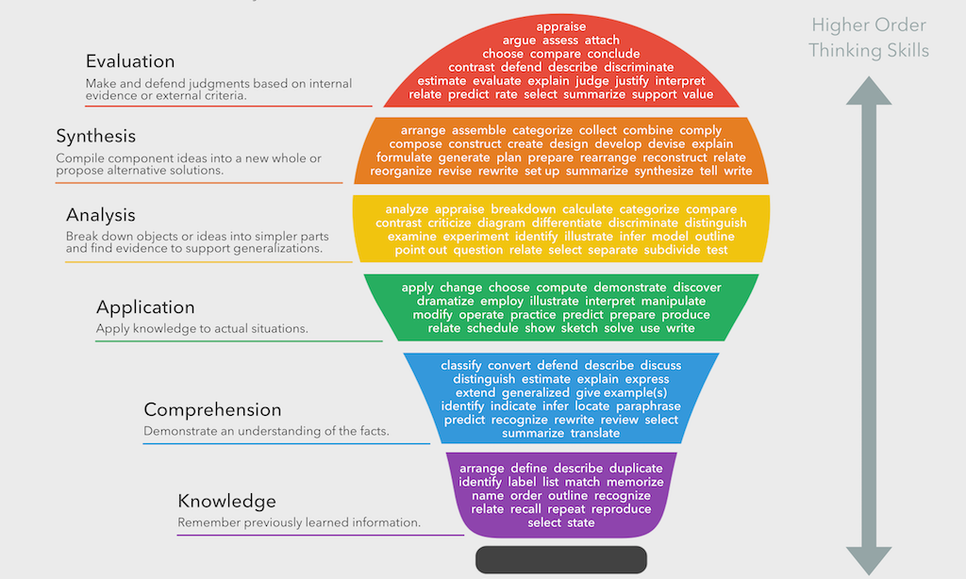
Notes:
Blooms Taxonomy

Slide 21
Integrating Course Content in Field
Examples of Knowledge, Values, and Skills
Social Work Knowledge
  Diversity
  At Risk Populations/Social and Economic Justice
  Human Behavior/Social Environment
  Research
Social Work Values
  Service
  Social Justice
  Dignity and Worth of the Person
  Importance of Human Relationships
  Integrity
  Competence
Social Work Skills
  Attending
  Building Rapport
  Clarifying
  Paraphrasing
  Reflecting Feelings
  Summarizing
  Stating Where the Client Is
  Probing
  Focusing
  Verbal Following
  Empathic Communication
  Confrontation
  Establishing Goals
  Identifying Tasks
  Contracting
  Educating
  Reframing
  Reviewing and Evaluating
  Termination

Slide 22
Integrating Course Content in Field
Questions to help students process their work:
What was the purpose of the work?
What were the knowledge, values skills used in the situation?
How were these elements used and why were they necessary for effective practice?
*Please also see supervision agenda template in Sonia

Slide 23
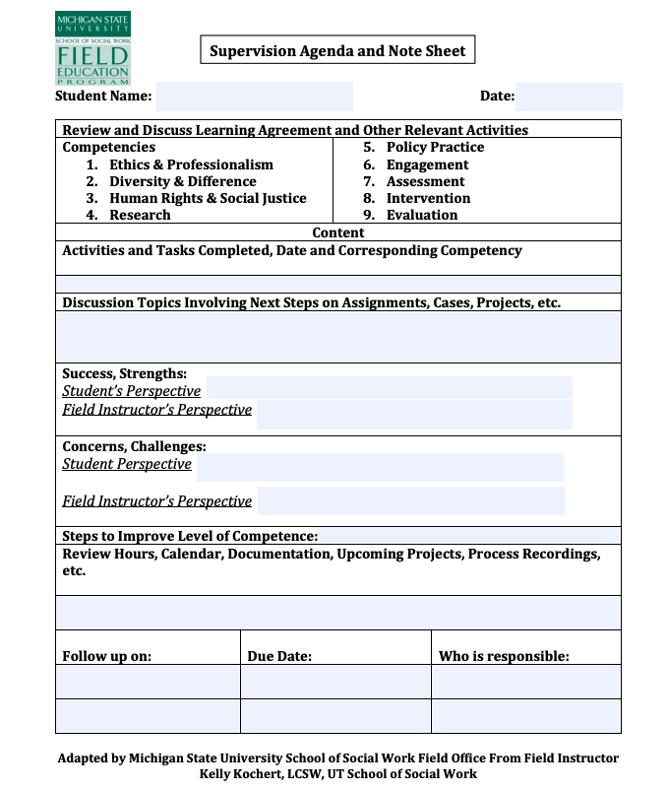
Notes:
This form not required but it can help students keep track of what has been accomplished throughout the week and some students have found it helpful in structuring their weekly supervision time with their field instructor. At the top of the form there is a list of the competencies and a section where it can be noted what activities and tasks have been worked on or completed. At the end of the semester sometimes students find that they did not have an opportunity to complete an activity they had originally put on their LET form. The opportunity may have never materialized through no fault of the own. Sometimes the agency may have thought the opportunity was going to be available and then it wasn’t, other times there may be a crisis that the agency needed to address and they could no longer provide that opportunity to the student. In instances like this, documenting activities and accomplishments on a regular basis can be very helpful as a student may find they still met the competency behavior it was just through another activity. If students are interested in utilizing this form, it can be found on the field education webpage under the student resources tab.

Slide 24
Paperwork

Slide 25
Process Recording
Required 1x/semester of all students
Gain insight into what occurred with a client or system
Used to establish
  Learning needs
  Knowledge gaps
  Ability to address issues which may influence clinical or organizational decisions
  Ability to work with individuals, teams, groups, etc.
  Knowledge of social work values, ethics, and human variability
  Agency/Field Instructor Resources
Notes:
Students are responsible for writing it but you are responsible for giving feedback. Listed are the areas you may want to address. We cannot be eyes on students with clients the entire time they are on site, it’s also not the purpose but we do want to ensure that students get feedback, even we FI’s are not with clients. Students feel nervous about decisions, interactions. This is an opportunity for you to validate or correct student engagement with clients.

Slide 26
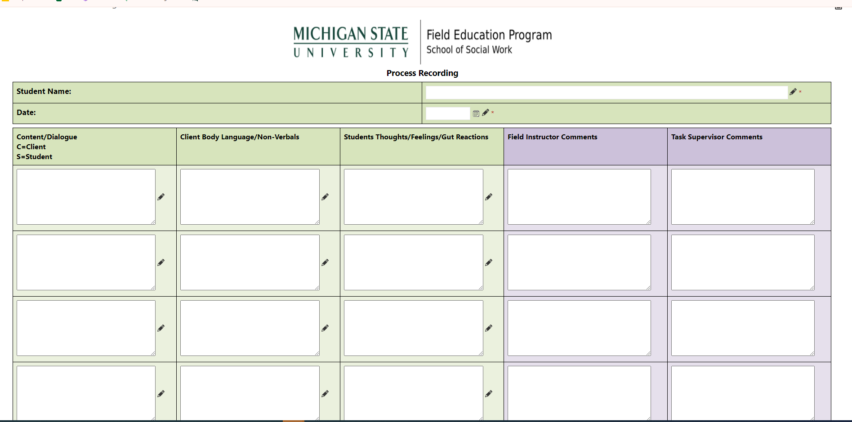
Process Recording

Slide 27
Learning & Evaluation Tool (LET)
1 tool completed in 2 parts
  Student responsibility to initiate beginning of semester
  FI responsibility to complete at end of semester
Activities must be
  Specific
  Measurable
  Achievable
  Realistic
  Time-bound

Slide 28
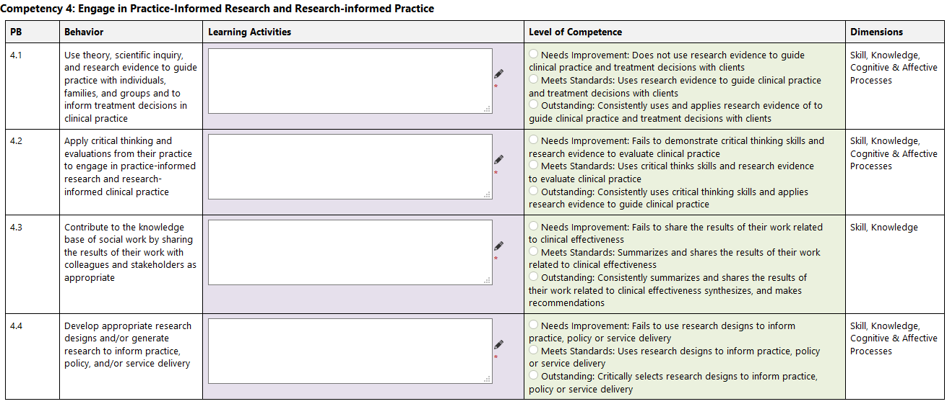
Notes:
Here is an example of what the LET form will look like in Sonia. In this example competency 4, Engage in Practice-Informed Research and Research Informed practice, is shown. In field education, students will address all 9 competencies.

Slide 29
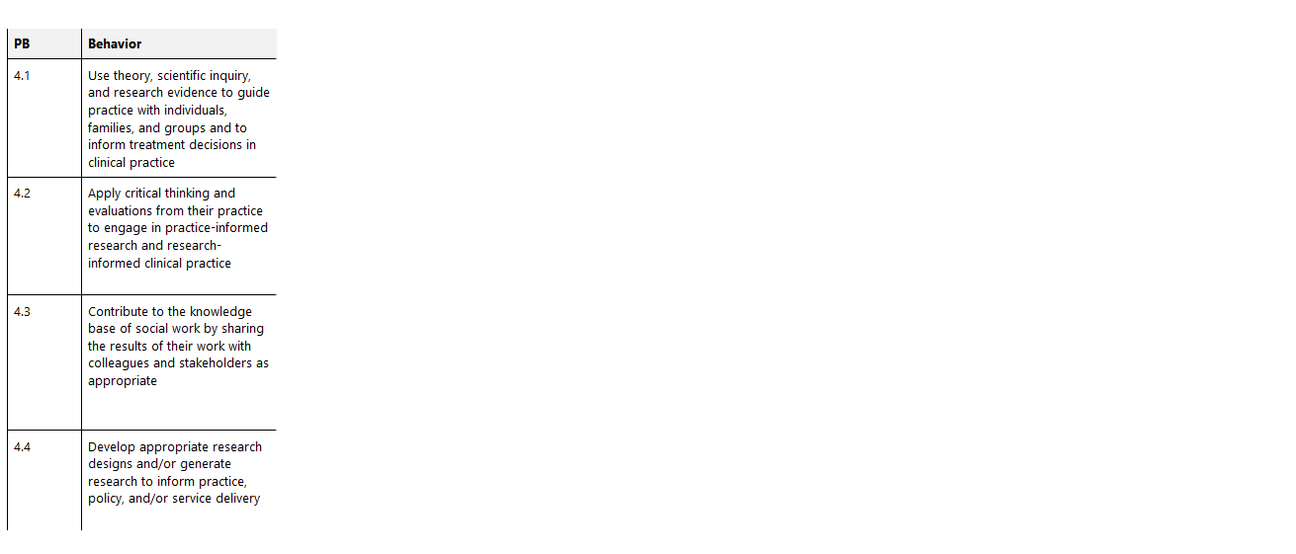
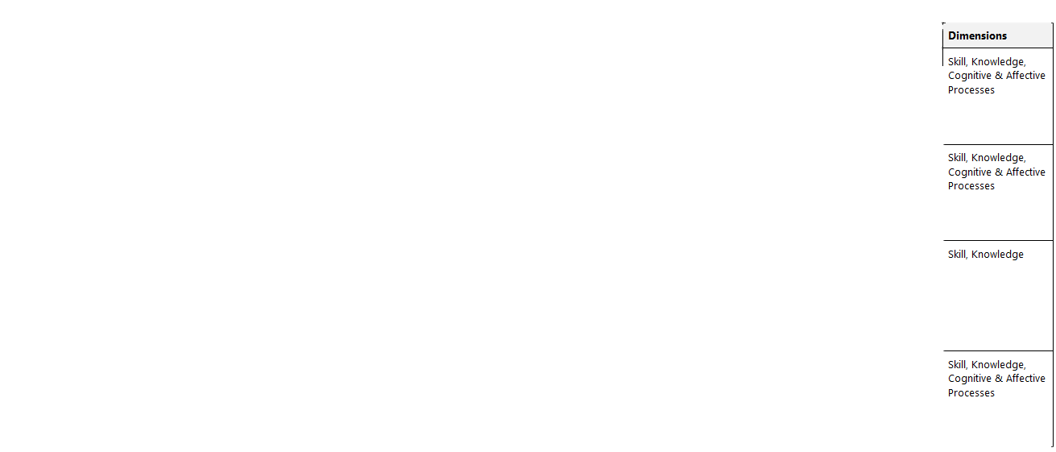
Notes:
For each of the 9 competencies, there are a set of behaviors that integrate the dimensions of competency. It is recognized that the demonstration of competence is informed by knowledge, values, skills, and cognitive and affective processes that include critical thinking, affective reactions, and exercise of judgement in regard to unique practice situations. On the LET form you will see the competency behaviors identified and the dimensions being evaluated for each behavior. In this example, the first two rows on the far-right side identify the 4 practice behaviors associated with competency 4 and on the far-left side the last row are listed the dimensions of the competency necessary for learning and developing competence. So, for competency 4, practice behavior 4.1 is use theory, scientific inquiry, and research evidence to guide practice with individuals, families, and groups and to inform treatment decisions in clinical practice and the dimensions evaluated for this behavior are skill, knowledge, and cognitive and affective processes.

Slide 30
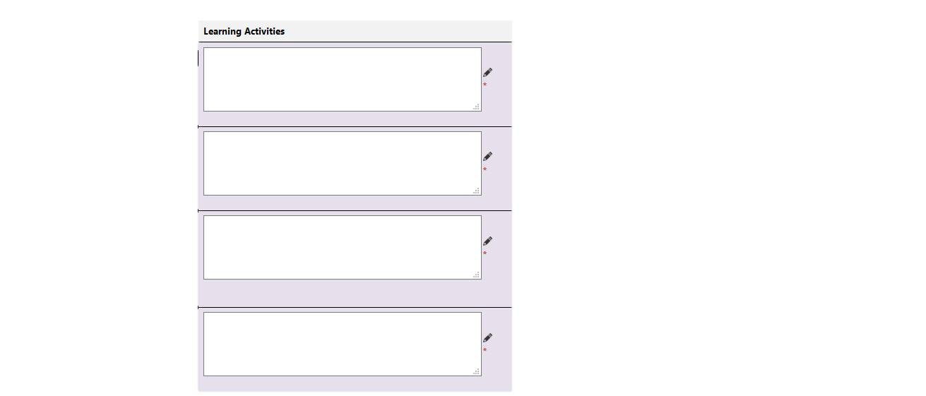
Notes:
The Learning Activities, highlighted here on the screen, is the learning agreement section of the LET. Students will identify learning activities for all 9 competencies and each associated behavior. A new learning agreement with new activities will be created each semester in consultation with the field instructor. The learning agreement is signed by the student and the field instructor and then it is reviewed and signed by the field liaison.

Slide 31
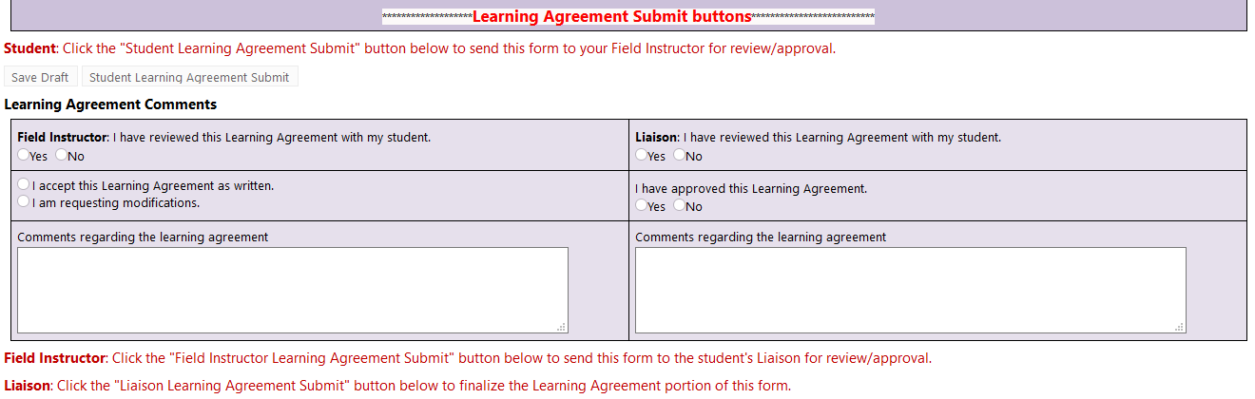
Notes:
Once the learning agreement is complete, it is signed by the student and the field instructor in Sonia. The learning agreement signature section will look like this in Sonia. Then the learning agreement is reviewed and signed by the field liaison.

Slide 32
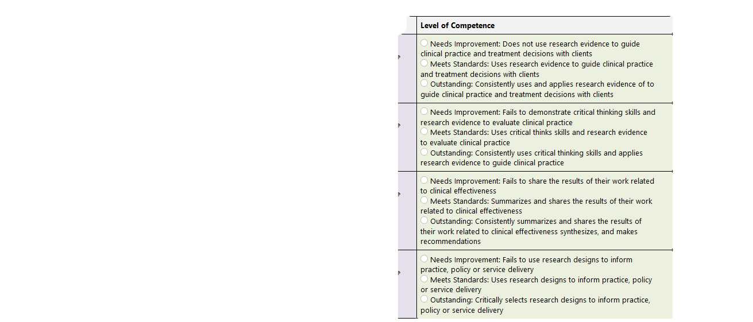
Notes:
At the end of the semester, Field Instructors are asked to evaluate the students’ performance in field. Evaluations provide feedback to students regarding their level of achieved competence based on the learning agreement. In addition, field instructors document whether or not the student has met course requirements and identifies areas for continued growth. The end of semester evaluation is completed by the field instructor, discussed with the student and signed by both by the due date. The student's signature indicates that they have read, but it does not necessarily imply agreement with the evaluation. There are three parts to completing the end of the semester evaluation.
The first part of the evaluation is to assess students’ performance on each behavior based on the activities located on the LET form. A student’s field instructor will consider each learning activity and rate a student as needs improvement, meets standards, or outstanding.

Slide 33
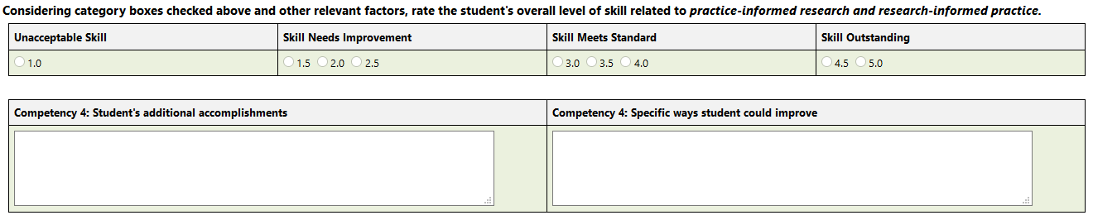
Notes:
Then the field instructor will rate the overall competency skill level for each competency. Skill is defined as the ability to do something well and use one's knowledge effectively and readily in performance. So, beyond the student’s performance on the activity identified for each behavior, field instructors are asked to consider other ways the student demonstrated skill related to each competency and to include that in the overall rating of the student’s skill for that competency. For example, a student may have Met Standards in completing the activity and yet were Outstanding in how they applied the competency consistently in other ways. Field instructors take these other relevant factors into account and then rate the student’s overall competency skill level using a 5-point Likert scale whereby 1 is unacceptable skill and 5 is skill outstanding.
It is important for students to recognize that demonstration of competence does not simply mean completing one activity one time during the semester, rather competence includes many factors. Competence is viewed as holistic. This holistic view recognizes that competence is multi-dimensional and composed of interrelated competences. So yes, each learning activity will be rated individually, but it is this second piece of the evaluation that represents that larger picture.
The field instructor should review the evaluation with the student. The field instructor should verify the number of hours and recommend a grade.

Slide 34
Evaluation and Grading
Semester evaluation based on learning agreement (signatures, date, grade, number of hours), attendance and participation in integrative field seminars, and input from field instructor and liaison
Grading is pass/no grade
Field instructor recommends a grade to liaison who reviews and submits recommended grade to coordinator

Slide 35
Competency 1: Demonstrate Ethical & Professional Behavior
What does it look like in practice?
Review NASW code of ethics and apply to case/scenario.
Follow agency policies and procedures.
Maintain confidentiality and informed consent.
Engage in reflective discussions with FI.
Maintain professional boundaries.
Dress appropriately for activity/setting.
Use professional language in all communication.
Be prompt/punctual/organized for client and agency interactions.
Practice appropriate, healthy, safe self care.
Maintain appropriate/professional social media presence and boundaries.
Prepare and participate in supervision regularly.

Slide 36
Competency 2: Advance Human Rights and Social, Economic, and Environmental Justice
What does it look like in practice?
Make appropriate community referrals.
Accurately consider systemic issues in assessment phase.
Utilize trauma informed approach with clients.
Adapt interviews to audience (various identities).
Engage in activities that further teach on diverse issues of community.
Report out on knowledge gained.
Participate in professional development.
Treat all clients with respect and dignity.
Use appropriate/professional language with clients.
Recognize when/how personal biases/privileges impact services to client (systems).

Slide 37
Competency 3: Engage in Anti-Racism, Diversity, Equity and Inclusion (ADEI) in Practice
What does it look like in practice?
Articulate/present knowledge of the impact of systemic oppression and discrimination of clients.
Educate client, agency, community on client rights.
Inform and provide access to resources for clients.
Promote self determination.
Participate in agency staff meetings, board meetings, policy reviews, community meetings, etc.
Prepare and present case consultations with colleagues/FI.
Advocate on behalf of client with other organizations (case advocacy).
Advocate for social cause important to agency, clients, community (cause advocacy).
Participate in fund raising efforts.

Slide 38
Competency 4: Engage in Practice Informed Research and Research Informed Practice
What does it look like in practice?
Review client records/notes looking for trends/patterns.
Gather multiple sources of information before making decision or recommendations.
Articulate variables that impact services.
Understand and apply evidence-based practices utilized within the agency.
Engage in evaluation of client progress.
Explore agency policy/practices and align with literature on evidence-based practices.
Assist with grant securing process.
Describe an agency program using logic model.

Slide 39
Competency 5: Engage in Policy Practice
What does it look like in practice?
Review and apply federal, state, local policies to agency practice.
Make appropriate community referrals.
Participate in review/revision process of agency policies/procedures.
Provide agency outreach services.
Engage in discussions/activities that improve service delivery.
Participate on multi-disciplinary teams or community coalitions.
Participate in agency accreditation activities.
Analyze policy & draft policy brief.

Slide 40
Competency 6: Engage with Individuals, Families, Groups, Organizations, Communities
What does it look like in practice?
Articulate micro-mezzo-macro levels of influence on clients.
Apply and discuss ecological systems theory on case(s).
Complete home visits.
Conduct client centered interviews.
Articulate how socioeconomic factors influence client functioning.
Utilize different techniques to engage clients.
Review client file/data prior to meeting.
Make follow up contacts with clients.
Engage in intake processes.
Participate in interagency/interdisciplinary meetings.

Slide 41
Competency 7: Assess Individuals, Families, Groups, Organizations, Communities
What does it look like in practice?
Correctly use agency tools/documentation.
Complete biopsychosocial assessments.
Correctly interpret data gathered from assessment tools.
Use agency data base to complete forms correctly.
Complete client interviews.
Interview family/community members.
Align data results with appropriate interventions.
Review agency quality improvement practices.

Slide 42
Competency 8: Intervene with Individuals, Families, Groups, Organizations, Communities
What does it look like in practice?
Implement agency interventions and supports with clear timelines and measurable outcomes.
Supervise implementation of treatment plan.
Implement case management services.
Make appropriate referrals.
Co-facilitate skill building, psycho-ed, group sessions.
Participate in agency meetings (case consults, staff meetings).
Advocate for clients during meetings.
Engage in progress review meetings.
Modify goals and interventions appropriately.
Network with other organizations.

Slide 43
Competency 9: Evaluate practice with Individuals, Families, Groups, Organizations, Communities
What does it look like in practice?
Report on agency data regarding clients served, services provided, and outcomes.
Articulate uniqueness of each client in evaluative processes.
Analyze client data to make appropriate recommendations.
Appropriately engage in termination/transition processes with clients.
Create agency action plan based on data collected.
Participate in program evaluation project.
Represent agency (with data) at community meeting.

Slide 44
Challenges in the Field Placement

Slide 45
Common Challenges in Field
Professional Behavior: dress/grooming, attitude, adherence to code of ethics, time management
Supervisor Relationship: teaching/learning style, misuse of supervisory meetings
Performance: time management, work quality, skill level, etiquette
Personal Issues: balancing school work, past issues, current issues, too many commitments
Client Relationships: rapport, professional relationship, applied interventions

Slide 46
How to Manage Student Issues
Provide student with immediate feedback
Be clear and concise
Inform student of required behavior change
Set a time frame
Follow up re: time frame, provide additional feedback, adjust as necessary
Document interventions using supervision tool
Address areas of growth and learning opportunities in Learning Agreement and /LET
Notify LIAISON/FIELD COORDINATOR immediately of any recurring issues, NASW violations, unprofessional behavior, harassment, discrimination or illegal behavior (HIPPA).

Slide 47
Paid Placement/Internship
Stipend: Now or in the future create a budget line or seek grand funding for intern stipends. Between $500-2500 is average.
Hourly Pay: Find ways to hire interns as part-time staff to compensate for the work they already to.
Employment Based Placement: If the student works for the agency—lets use the paid position as field credit.
AmeriCorps: Partner with AmeriCorps for part time positions.
Federal Work Study Partnership: Need based award up to $3k/year. Reimburses agency 70%.

Slide 48
Remember to also check Field Education Website for more info on Sonia system. https://socialwork.msu.edu/Programs/Field-Education
Notes:
Dates to be mindful of: semester start dates, learning agreement due dates, evaluation due dates.

Slide 49
Contacts
Julie A. Navarre, LMSW
Director of Field Education
517-432-3722
navarre@msu.edu
Leisa Fuller, LMSW
Assistant Director of Field/EL Coordinator
517-353-8631
fullerle@msu.edu
Cheryl Williams-Hecksel, LMSW
EBTT Certificate Field Coordinator
517-432-1659
will1534@msu.edu
Nicki Moody, LMSW, ACSW
BASW/EL Generalist Field Coordinator
517-353-2999
nmoody@msu.edu
Caitlin Rogell-Jones, LMSW, MPH
Statewide/Weekend/OCL Field Coordinator
517-353-9745
rogellca@msu.edu
Natasha Mwanakatwe
Field Office Coordinator
517-353-8621
mwanakat@msu.edu

Slide 50

We CANNOT do it without YOU!!!!!

